Slide 1
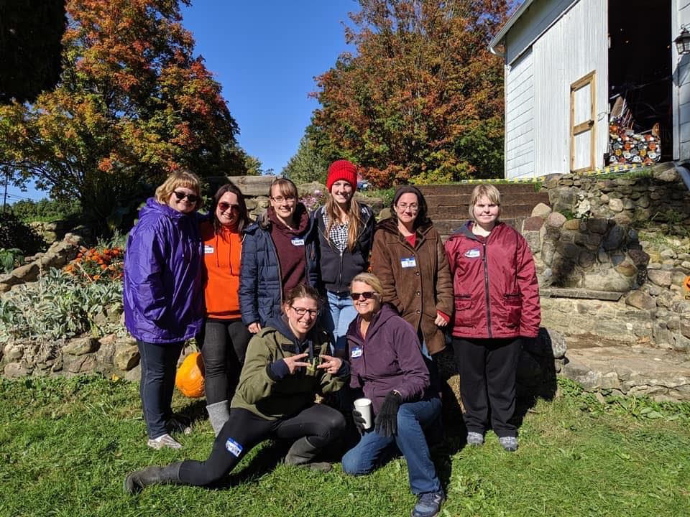
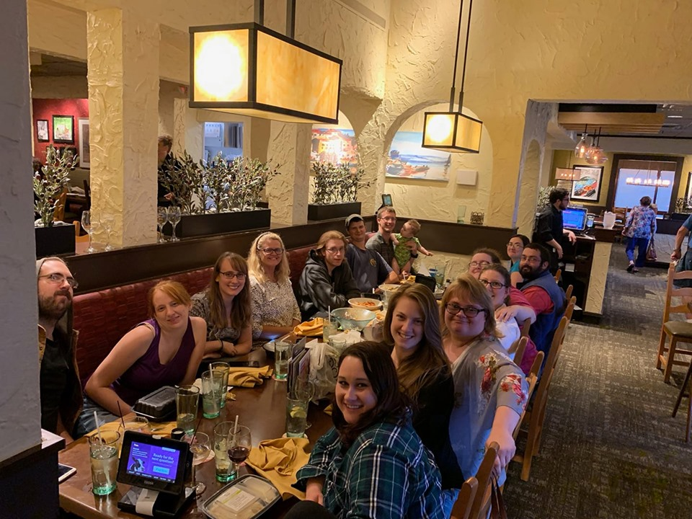
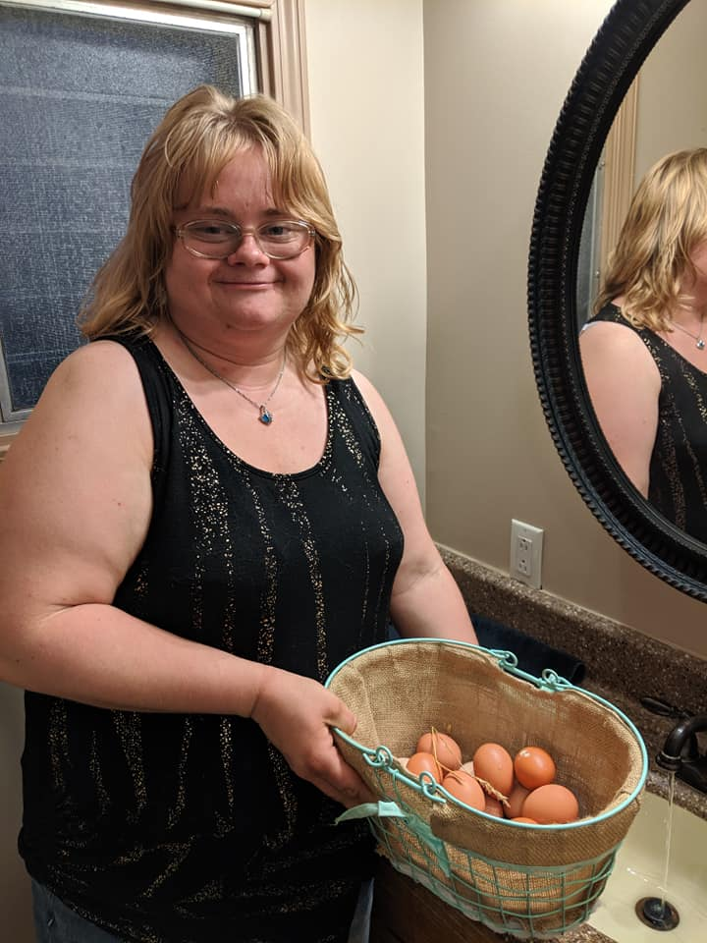
S.A.G.E. (Serving and Growing Experience)
Adapted young adult Bible study

Slide 2

The experience
Meetings are at the Helping Hands Farm
Meetings happen every other week, with a focus on discipleship and 1:1 hangouts off weeks
Meetings consist of pizza & snacks, adapted Bible study, then farm activities

Slide 3
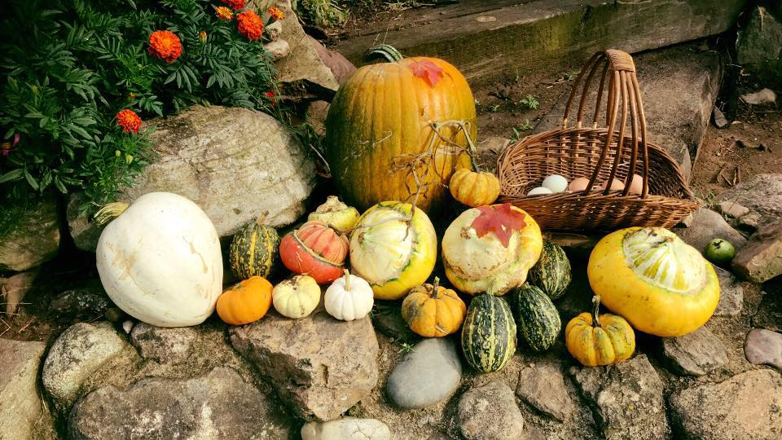
Average attendance: 6 people who don’t go to another homechurch,
2 First timers in the last 4 meetings
Workers: Emily F., Hannah I., Brandi B., Dan W., Seth B., Josh R.
Leaders: Indre, Laura, Schiffers

Slide 4
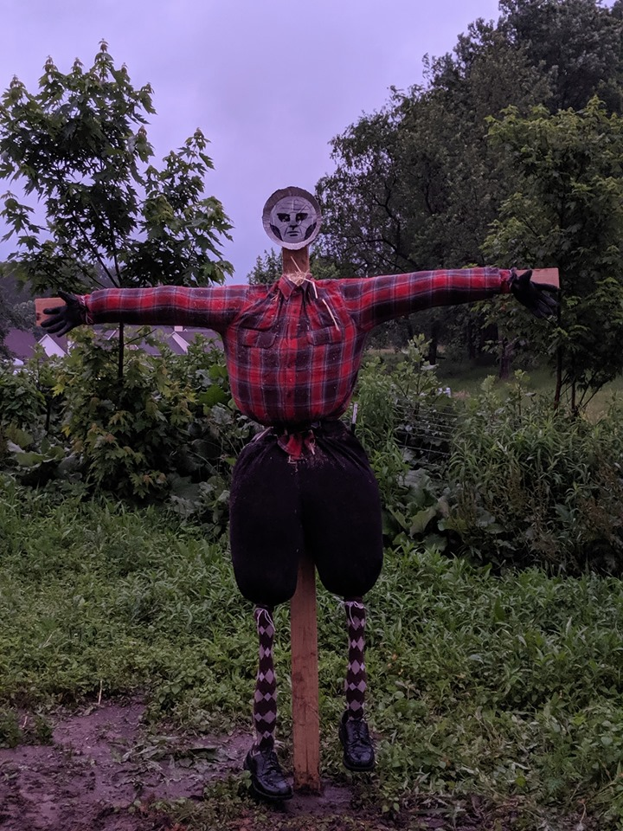
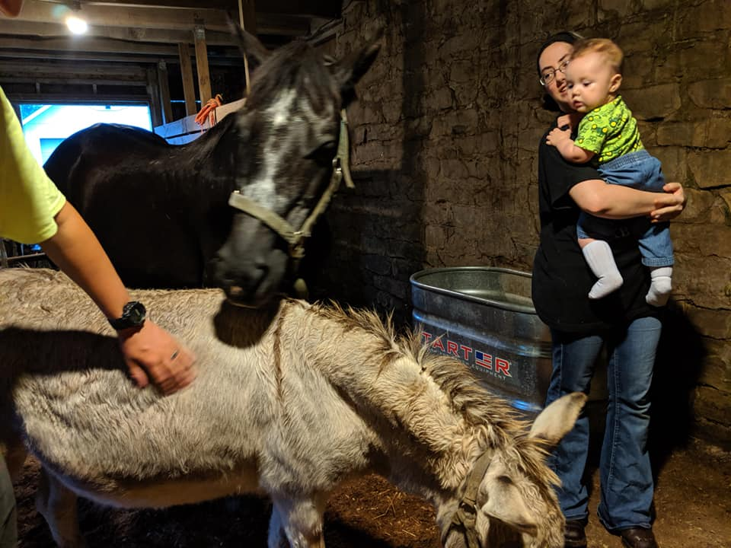
Wins
Losses
Bryan, Liz & Eddy Hodgeman
Rachel Tyson
Brittany
3 salvations
CCS Students on Kent’s campus

Slide 5

Upcoming Challenges
Passing on hope to our new members who are struggling (family loss, anxieties, jobs)
Getting our new members firmly rooted in God’s truths
Consistent attendance
Building our 1:1 relationships
Activities for winter time
Prayer Requests
More Helping Hands Farm employees (1 new hire = Emily F.)

